Slide 1

Distributed Code Collaboration

Slide 2
What is Git? Why do we need it?
Git basic blocks and operations (abstract)
Working locally with Git
Working remotely with Git

Slide 3
What is “version control”?
A system for storing different versions of code, moving freely between them, and collaborating with other developers on each version.
Things you can do with version control:
Undo changes
Create backups
Maintain multiple versions of a product
Compare two versions, to see what has changed
Review the history of development
Track who wrote what, and when
Accept patches from someone else in a controlled manner

Slide 4
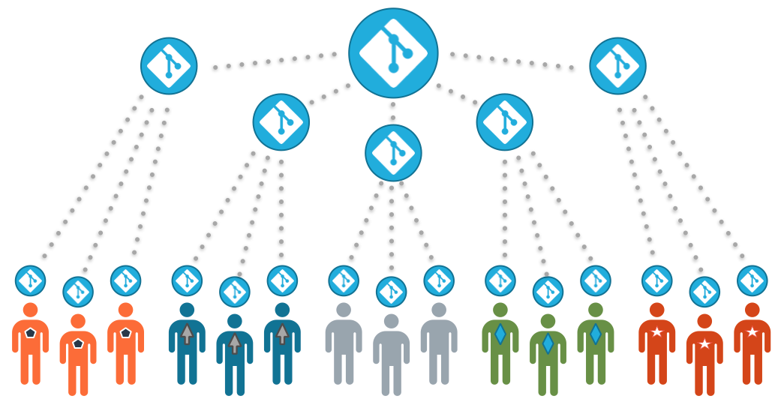
What is Git?
Git is a distributed version control system.
Instead of having a single server with many clients, everyone is both a server and a client. The entire codebase + history is mirrored on every developer’s computer.
Advantages:
Flexible development model
Work offline
Allows Incremental Upstream flow
Disadvantages:
More potential for confusion
No locks
Harder to learn

Slide 5
What is Git? Why do we need it?
Git basic blocks and operations (abstract)
Working locally with Git
Working remotely with Git

Slide 6
Git - Basics
Git stores changes incrementally, in order to be more efficient in space and computation. It’s also a convenient way to think of progress in the code-base.
def is_dividable_by_zero(val):
try:
result = val / 0
return True
except ZeroDivisionError:
return "False"
def is_dividable_by_zero(val):
try:
result = val / 0
return True
except ZeroDivisionError:
return False
return True
except ZeroDivisionError:
- return "False"
+ return False

Slide 7
Git Basic Blocks - The Commit
The most basic git object is the commit, also called a patch. It signifies an incremental change (aka diff) in the source code.
class Commit : GitObject {
id
message
author
date
diff
prev : Commit
}
HEAD
Bugfix: “Hello”
-Helo
+Hello
Added “Helo world”
main() {
+printf(“Helo World”);
}
Initial
main() {
}

Slide 8
Git Basic Blocks - The Branch
A branch is a split in the commit history, represented as two (or more) commits pointing to the same commit.
Master
(HEAD)
Experimental
(HEAD)
Added pink ghost
Added teleport
Added Pacman
Added maze

Slide 9
Git Basic Blocks - The Merge
A merge is a special object that unites two branches into one.
master
(HEAD)
Added 2 ghosts
class Merge: GitObject {
id
message
author
date
diff
merge_from: Commit
merge_to: Commit
}
Added pink ghost
blue (HEAD)
Added blue ghost
Added Pacman
Added maze

Slide 10
Git Basic Blocks - The Merge
A “complex” workflow
master (HEAD)
Merge ghost #2
pink (HEAD)
Fixed pink ghost
Added pink ghost
Merge ghost #1
blue (HEAD)
Added blue ghost
Added Pacman
Added maze

Slide 11
Git - Rebase
Rebase lets us re-write the commit history:
Re-order commits
Edit commits
Join commits (squash)
Delete commits
With great power, comes great responsibility!
Warning:
Revising history that already exists elsewhere will cause merge collisions when trying to merge the changes.
You can accidentally delete important changes, so always backup beforehand!

Slide 12
Git - Rebase
Rebase can be used to:
Create a cleaner commit history
Clean alternative to merge
Clean history is like clean code:
Easier to review
Easier to undo
Easier to diff
Master (HEAD)
Added pink ghost
blue (HEAD)
Added blue ghost
Added Pacman
Added maze

Slide 13
Git - Rebase
Example of rebasing one branch into another branch
Master (HEAD)
Master (HEAD)
Added pink ghost
Added pink ghost
blue (HEAD)
Added blue ghost
Rebase
Added blue ghost
Added Pacman
Added Pacman
Added maze
Added maze

Slide 14
What is Git? Why do we need it?
Git basic blocks and operations (abstract)
Working locally with Git
Working remotely with Git

Slide 15
Working with Git - Create repository
First, we need to create a local repository.
Git repos contain the entire history of the project (all diffs, all branches, etc.).
Create a new empty repository
$ mkdir repo && cd repo
$ git init
Work with an existing repository
$ git clone http://myrepos.com/path/to/repo
$ cd repo

Slide 16
Working with Git - Repo Status
At any point, use a status check to keep track of the current changes
$ git status

Slide 17
Working with Git - Create commits
In Git, the source of truth is the repository database. Changes to the local files need to be explicitly commited.
Commit specific changes
$ git add file1
$ git add src/file2.c
$ git commit -m “This is a commit message”
Commit all changes
$ git commit -a -m “All changes”
# Add to staging
# Add to staging

Slide 18
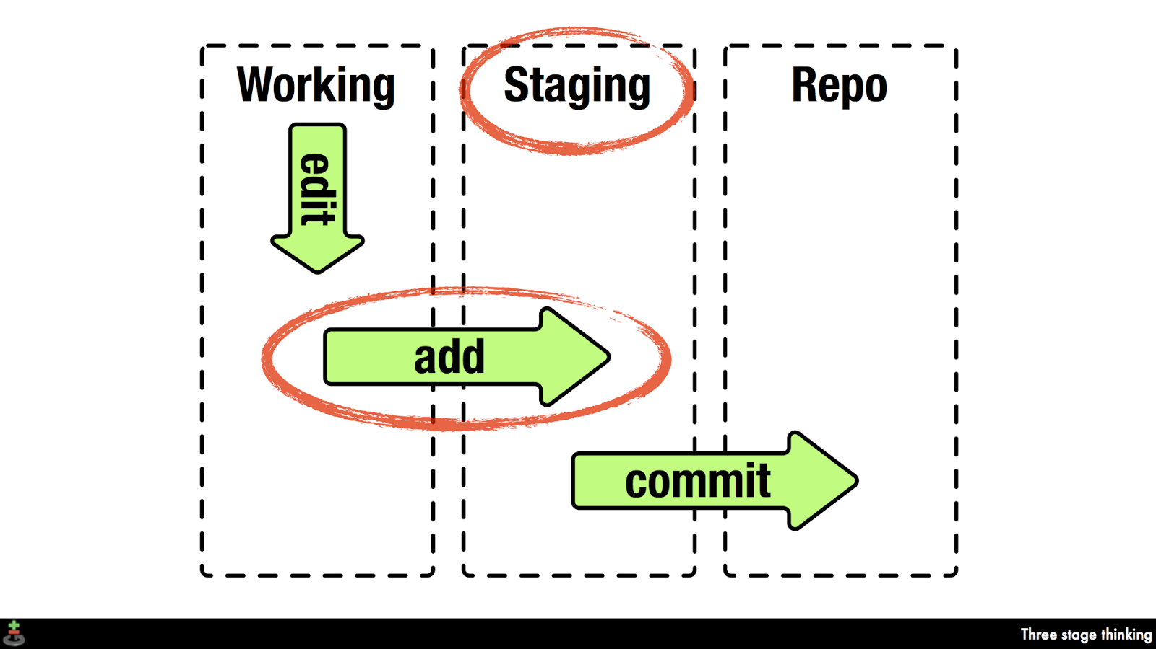

Slide 19
Working with Git - Viewing the commits
The full history of ours commits is always available
List the commit history
$ git log
$ git log HEAD~
$ git log <hash>
Show a commit
$ git show
$ git show HEAD~
$ git show <hash>
# List from HEAD
# Show HEAD commit
# List from before HEAD
# List from <hash>

Slide 20
Working with Git - Viewing Differences
We can view the difference between any sequence of commits
$ git diff HEAD~
$ git diff HEAD~10
$ git diff new_branch
$ git diff branch1 branch2
$ git diff <commit1> <commit2>
# Show last commit (Like “git show”)
# Show the last 10 commits

Slide 21
Working with Git - Working with branches
New commits are always appended to the current branch.
Create branch “new_branch”
(it is now the current branch)
$ git checkout -b new_branch
List all branches
$ git branch
* master
new_branch
Go back to “master” branch.
$ git checkout master
Delete “new_branch”
$ git branch -d new_branch

Slide 22
Working with Git - Merging branches
Merge “new_branch” into current branch
$ git merge new_branch
When there are merge conflicts, you can choose to fix them and resume the merge with:
$ git add <files_changed>
$ git commit
Make sure a merge-commit is create
$ git merge new_branch --no-ff
Or abort the merge with:
$ git merge --abort

Slide 23
Working with Git - Rebasing branches
Rebase “new_branch” on top of current branch
$ git rebase new_branch
Rebase the last 10 commits interactively
$ git rebase -i HEAD~10

Slide 24
What is Git? Why do we need it?
Git basic blocks and operations (abstract)
Working locally with Git
Working remotely with Git

Slide 25
Working with Git - Downloading changes
Download all the changes
$ git fetch
Download all changes and merge
the current branch
$ git pull
Download all changes and merge
$ git fetch
$ git merge origin/master

Slide 26
Working with Git - Uploading changes
Push the current branch
$ git push
Push a specific branch
$ git push origin some_branch

